Slide 1
Bakery Sales Analysis
Analyzing sales trends, top products, and peak transaction times
By Dhimas Andreas Prayoga

Slide 2
Business Objective
This analysis aims to understand bakery sales performance by identifying:
• Sales trends over time
• The top-selling products
• The busiest days of the week
• The peak hours of customer activity
Context
Problem statement

Slide 3
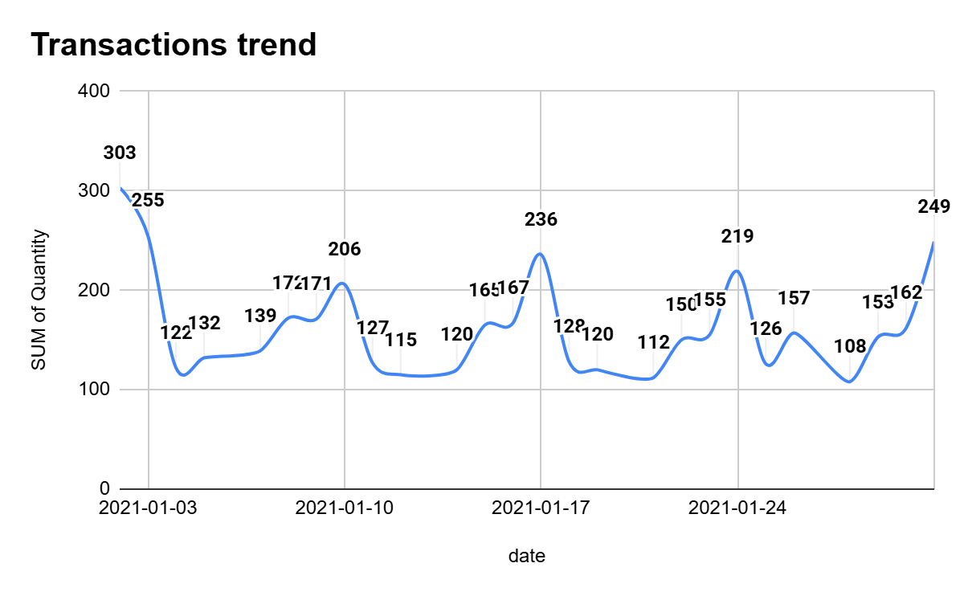
Sales Trend Over Time

Slide 4
Sales Trend Over Time
Insight:
• Sales fluctuate across the observed period.
• Certain dates show spikes in transactions, indicating higher demand.
• Understanding this trend helps anticipate inventory and staffing needs.

Slide 5
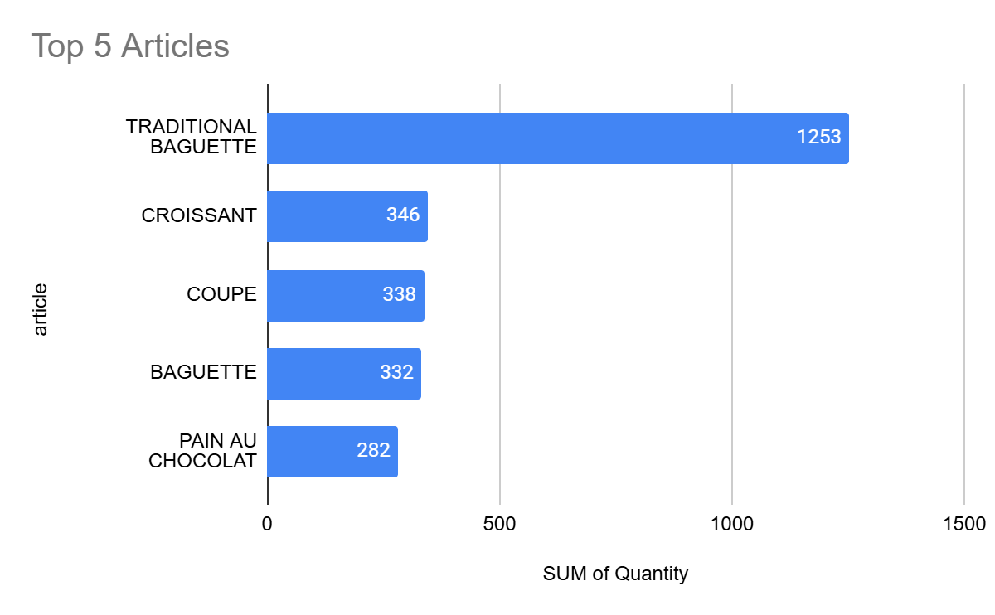
Top 5 Best-Selling Articles

Slide 6
Top 5 Best-Selling Products
Insight:
A small number of products dominate total sales.
These products represent the bakery's core revenue drivers.
Ensuring consistent availability of these items is crucial.

Slide 7
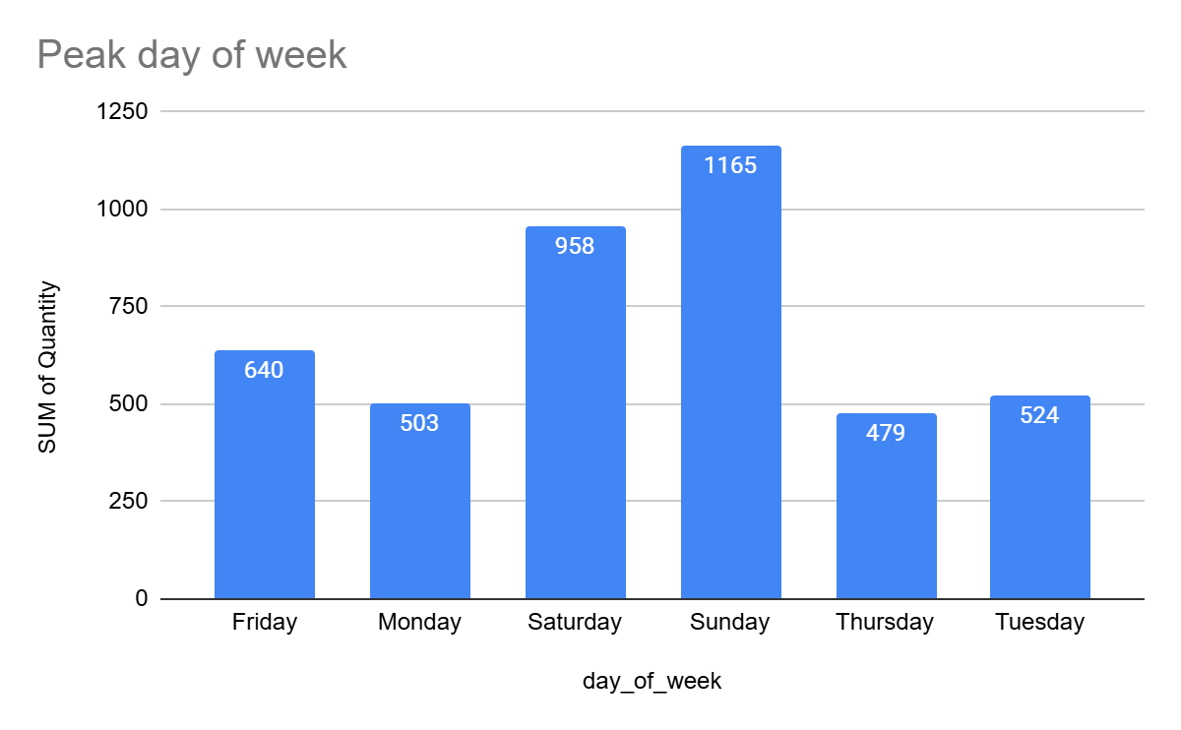
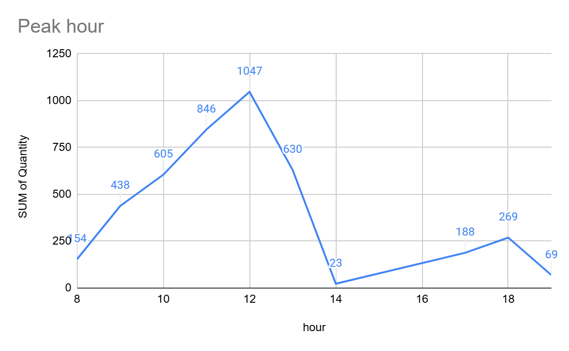
Customer Purchase Behavior

Slide 8
Customer Purchase Behavior
Insight:
Customer traffic varies across days of the week.
Certain hours show significantly higher sales activity.
Peak times indicate when operational capacity should be optimized.

Slide 9
Key Insights & Business Recommendations
Insight:
• Sales are concentrated in specific days and hours.
• A few products contribute the majority of sales.
• Customer purchasing behavior follows predictable patterns.
Recommendations:
• Increase production for top-selling items.
• Allocate more staff during peak hours.
• Use promotions to increase sales during slower periods.

